Slide 1
Intro to Programming Final Project
Patrick Meeks

Slide 2
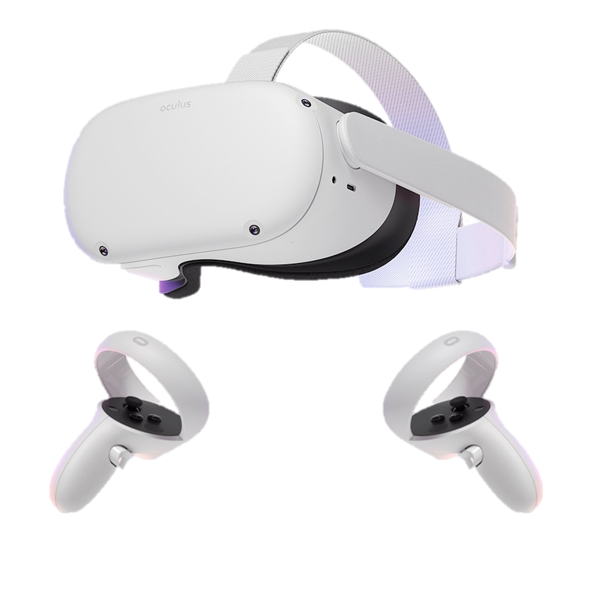
What is the project?
VR environment
Goals
Moving player
Interactable
Accessibility
Playability

Slide 3
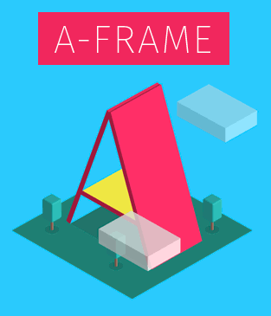
Why this project?
A-frame
Oculus Quest
Video games
Me as a musician

Slide 4
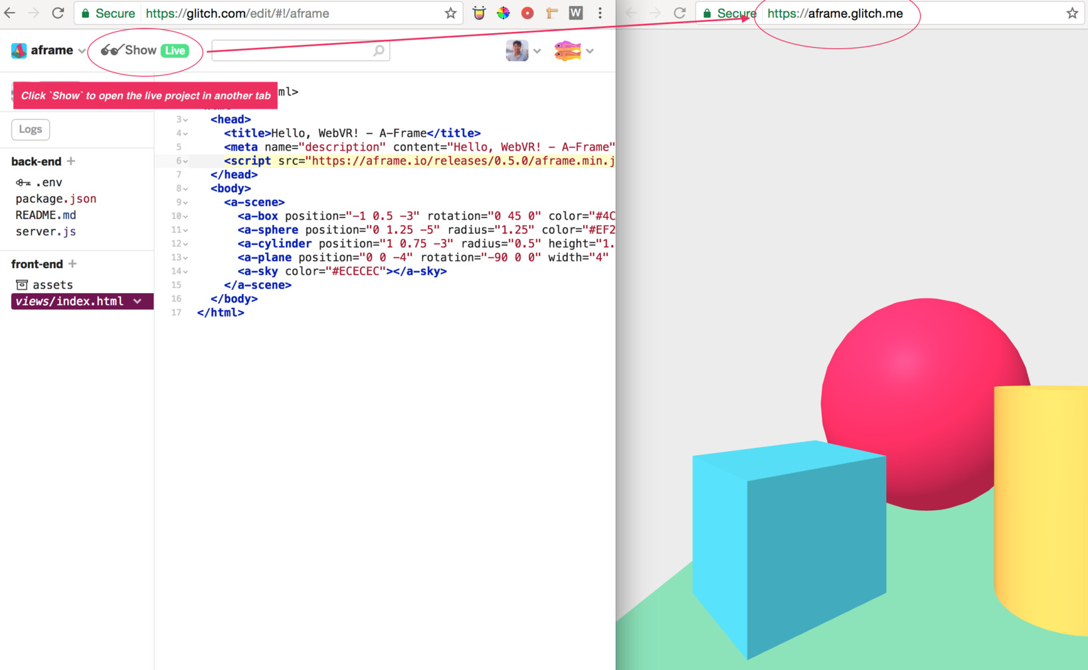
How does it work?
A-frame
HTML
Glitch
Live preview

Slide 5
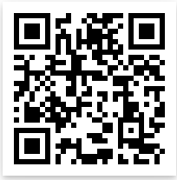
DEMO!
Live Demo
Code

Slide 6
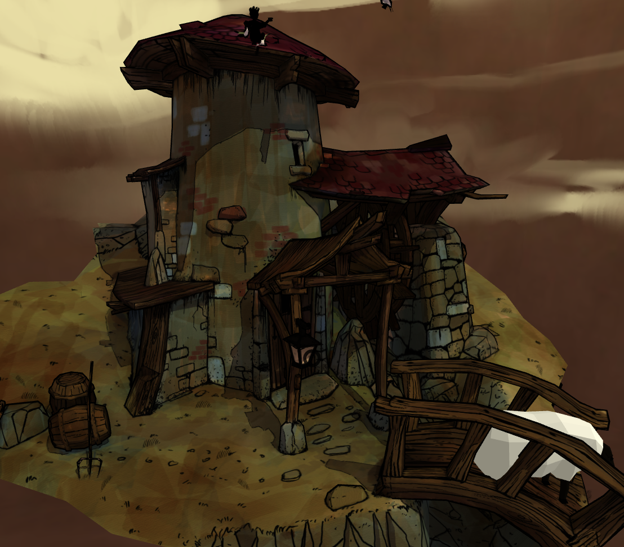
What works?
Accomplished goals
Movement
Interactable
Accessibility
Playable
Glitch live preview

Slide 7
What doesn’t work yet?
Object physics
In-game events
Not entirely accessible?
Problems with play testing

Slide 8
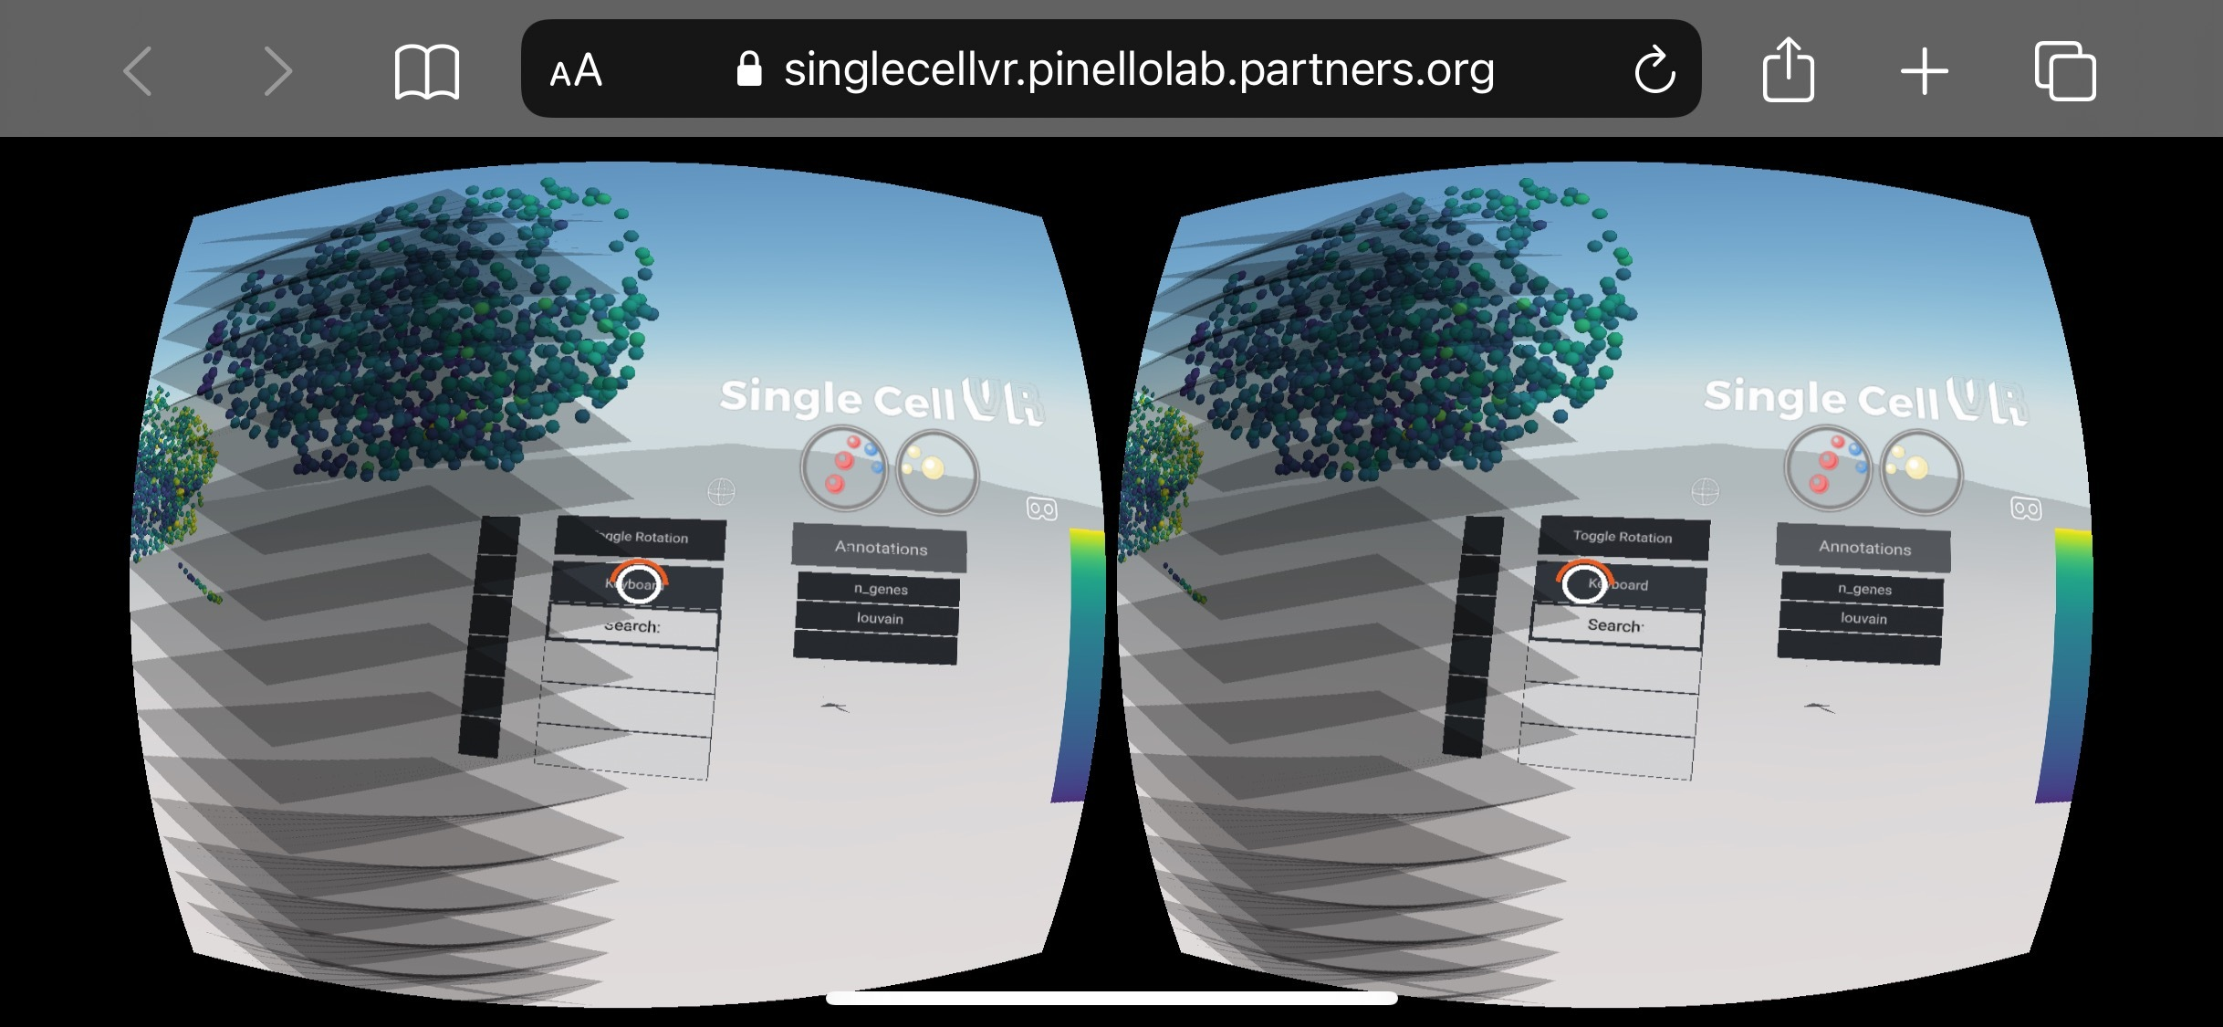
Future Implementation
Actual game scene
Characters, dialogue, etc.
Visual inspector
Importing 3D images

